Slide 1
Distributed Online Clustering using LSH over Multiple Data Streams
Alok Kumbhare, Ketan Singh
Yan Liu
University of Southern California

Slide 2
Motivation
Terabytes of data in Social Network streams.
Facebook, Quora, Twitter.
Variety of Big Data
Unbounded cluster sizes.
Data rate is not consistent.
Consider Christmas day feeds!!

Slide 3
Challenges
Continuous Streaming data.
Dynamically changing data rates.
Clear and fast identification of outliers.
Fast and incremental processing of new data points.
Notes:
Add references.

Slide 4
Online Clustering
Start with C = ɸ
For each incoming message m
Ĉ = Get Candidate Clusters(m,C)
For each cluster c in Ĉ
D[c] = DistanceFromCentroid(m,c)
D, minC = min{D[c], c | c in Ĉ}
If(D < T)
minC = minC U {m}
Else
newC = {m}
C = C U newC

Slide 5
Naïve Approach
Start with C = ɸ
For each incoming message m
Ĉ = C
For each cluster c in Ĉ
D[c] = DistanceFromCentroid(m,c)
D, minC = min{D[c], c | c in Ĉ}
If(D < T)
minC = minC U {m}
Else
newC = {m}
C = C U newC

Slide 6
Locality Sensitive Approach
Start with C = ɸ
For each incoming message m
Ĉ = {LSH(C, m, n)}
For each cluster c in Ĉ
D[c] = DistanceFromCentroid(m,c)
D, minC = min{D[c], c | c in Ĉ}
If(D < T)
minC = minC U {m}
Else
newC = {m}
C = C U newC
Tradeoff between “n” and accuracy

Slide 7
Locality Sensitive Approach - Bottlenecks
Serial calculation of distance measures
Assumes *all* candidate clusters are available in single machine
Start with C = ɸ
For each incoming message m
Ĉ = {LSH(m,n)}
For each cluster c in Ĉ
D[c] = DistanceFromCentroid(m,c)
D, minC = min{D[c], c | c in Ĉ}
If(D < T)
minC = minC U {m}
Else
newC = {m}
C = C U newC

Slide 8
Distributed Locality Sensitive Approach
Serial calculation of distance measures
Assumes *all* candidate clusters are available in single machine
Start with C = ɸ
For each incoming message m
Ĉ = {LSH(m,n)}
For each cluster c in Ĉ
D[c] = DistanceFromCentroid(m,c)
D, minC = min{D[c], c | c in Ĉ}
If(D < T)
minC = minC U {m}
Else
newC = {m}
C = C U newC

Slide 9
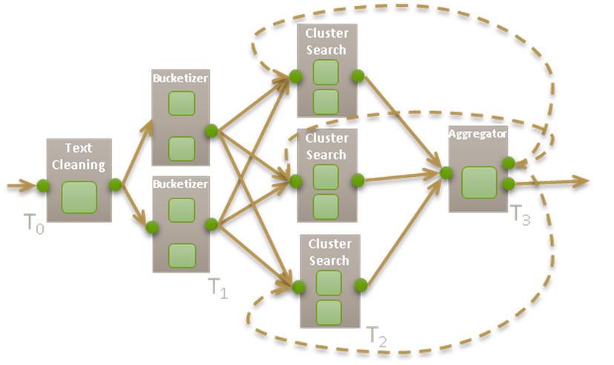
Application Architecture

Slide 10
Techniques Used
Hash Functions:
MinHash

Slide 11
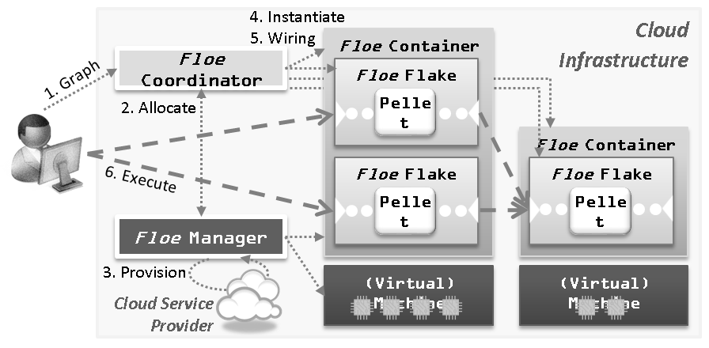
Floe

Slide 12
Results

Slide 13
References

